Slide 1


OS-Project
Project name:
Enhancing Functionality and User Experience: A Comprehensive Overview of Implementing Command Line Comments in OS Projects
Represented by:
C201049 (Naimul)
C201060 (Riaz)
C201127 (Sayem)
Represented to :
G.M Arafat Shaown
Assistant lecturer ,CSE- IIUC

Slide 2

Introduction
This presentation provides an overview of implementing command line comments in OS projects. The focus will be on enhancing functionality and user experience. The presentation examines the beneﬁts of command line comments and offers practical suggestions for
implementation.

Slide 3

What are Command Line
Comments?
Command line comments are a way to communicate with a computer system through text-based commands. They allow users to interact with the system in a more efﬁcient and ﬂexible way.
This slide will examine the key features and beneﬁts of command line
comments.

Slide 4

Benefits of Command Line Comments
Command line comments offer several beneﬁts including increased efﬁciency, ﬂexibility, and automation. They enable users to perform complex tasks with ease and speed. This slide will explore the beneﬁts of command line comments in
more detail.

Slide 5
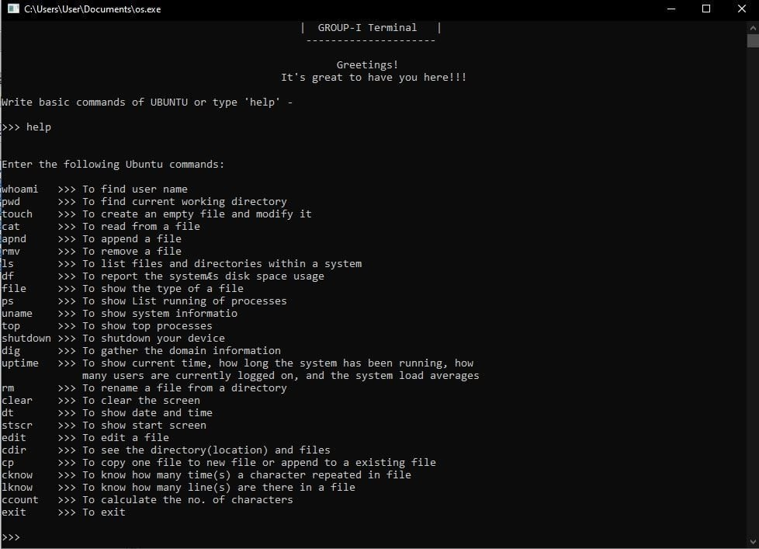
Overview of Ubuntu all commands

Slide 6




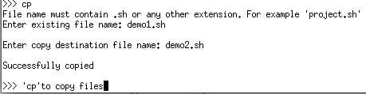

Working procedure with command
To show date. We used “dt” command.
To clear screen. We used “clear” command.
To edit an existing file. We used “edit” command.
To show directory. We used “cdir” command.
To copy an existing file . We used “CP” command.
To show no of lines . We used “Iknow” command.

Slide 7
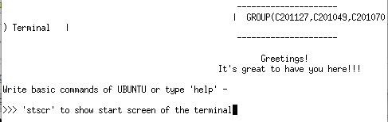



To show start screen. We used “stscr” command.
To know number of characters. We used “count” command.
To show how many times a character repeated. We used “Cknow” command.
To exit screen. We used “exit” command.

Slide 8

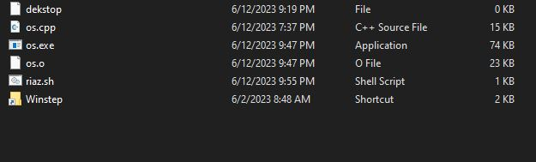

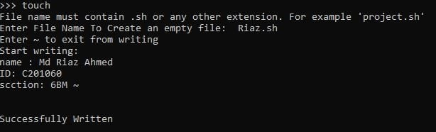
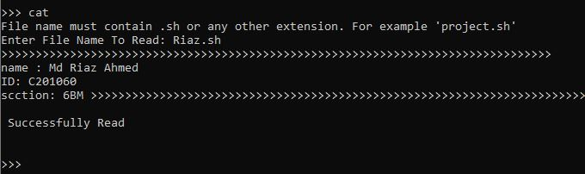


Slide 9
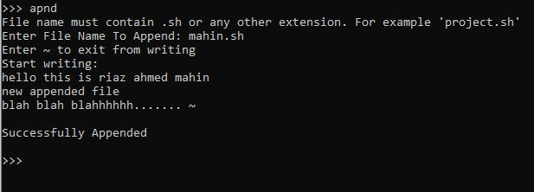
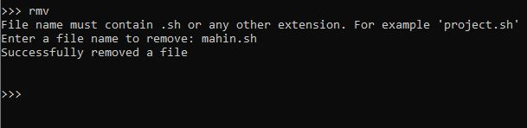
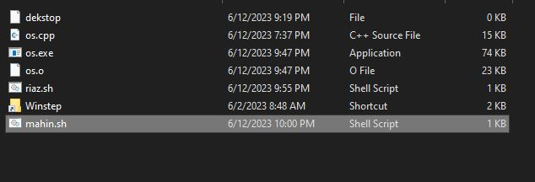
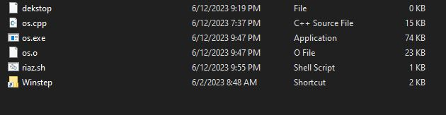

Slide 10
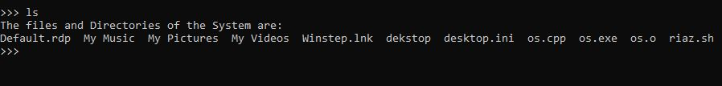
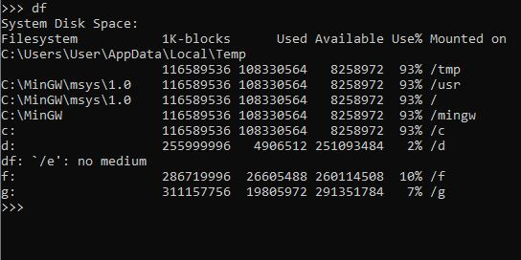

Slide 11
Conclusion
In conclusion, implementing command line comments in an OS project can greatly enhance functionality and user experience. By following best practices and carefully planning and executing the implementation process, developers can create powerful and efﬁcient systems that meet user needs. Thank you for listening.

Slide 12
Thanks
This is all from our team .

